Slide 1

Waste Management System
"Transforming waste into opportunity with smart, AI-driven waste management for a cleaner and more sustainable future."

Slide 2
System Architecture
Frontend Dashboard
Backend API
Database
Web interface for monitoring the waste management ecosystem.
Node.js and Express.js server handling data processing and business logic.
MySQL database storing all system information.

Slide 3



Key Use Cases
Predictive Waste Collection
Waste-to-Energy Conversion
Composting & Agricultural Waste
Utilizing smart sensors and AI for efficient waste collection in urban areas.
Converting waste into a valuable energy source, reducing landfill usage.
Turning organic waste into compost for agricultural use.

Slide 4
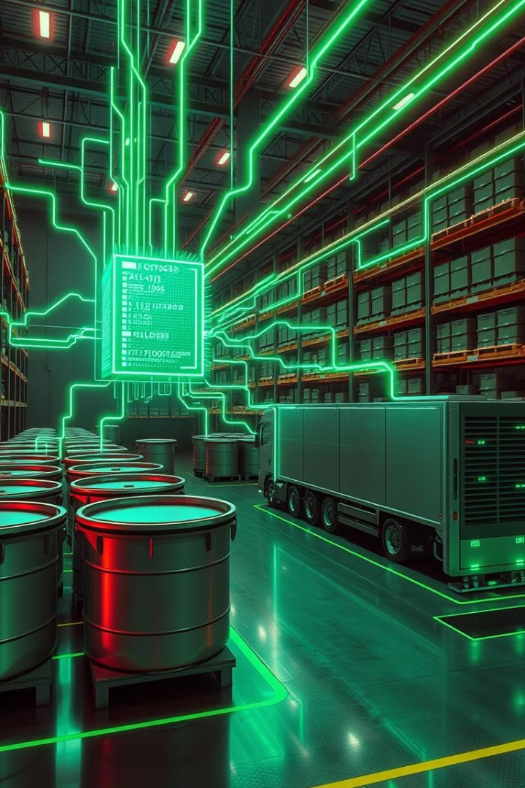
Data Management
Waste Bins
Processing Facilities
Location, fill level, waste type, collection history.
Capacity, operational status, geographic distribution.
Collection Vehicles
Real-time location, load capacity, route optimization.

Slide 5




Key Features
Smart Bin Monitoring
Route Optimization
Environmental Impact
Real-time fill level tracking and automated alerts.
Dynamic routing based on bin fill levels.
Carbon footprint reduction metrics.

Slide 6

Technical Implementation
1
Hardware
The system requires a server, database, and network infrastructure to support real-time monitoring and data analytics.
2
Software
web-based application, mobile app, and API to support user interaction and data exchange.
3
Database
The system requires a database management system to store and manage waste collection data.

Slide 7

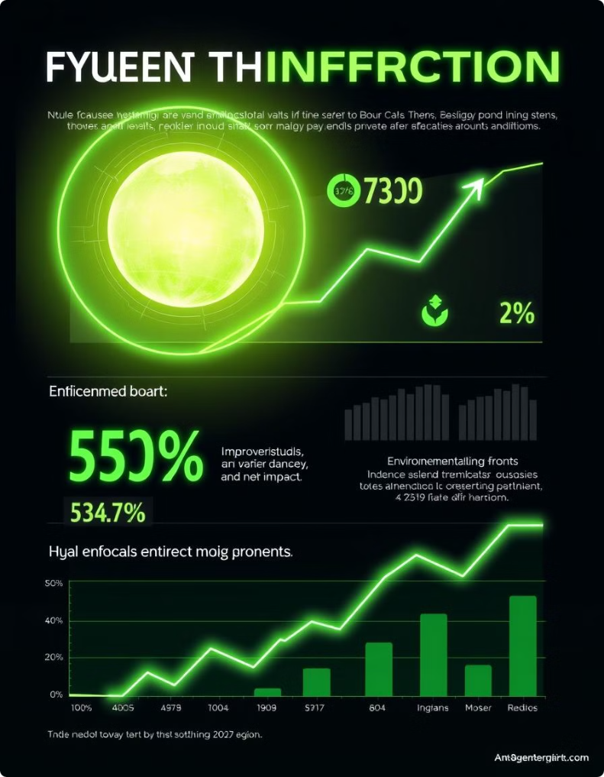




Benefits and Impact
Environmental Benefits
Optimized collection routes reduce fuel consumption, lowering CO₂ emissions.
Urban and Smart City Benefits
Timely waste disposal reduces pests, disease outbreaks, and unpleasant odors
High Initial Investment
IoT sensors, AI models, and cloud infrastructure require significant upfront costs.
Sensor Malfunctions & Data Inaccuracy
Sensors may fail due to environmental factors (rain, dust, tampering).

Slide 8



Future Enhancements
IoT Expansion
2
AI-powered sensors.
Conveyor Belt
Machine Learning
1
Predictive fill level forecasting.
Community Engagement
3
Mobile and laptop website for resident reporting.

Slide 9
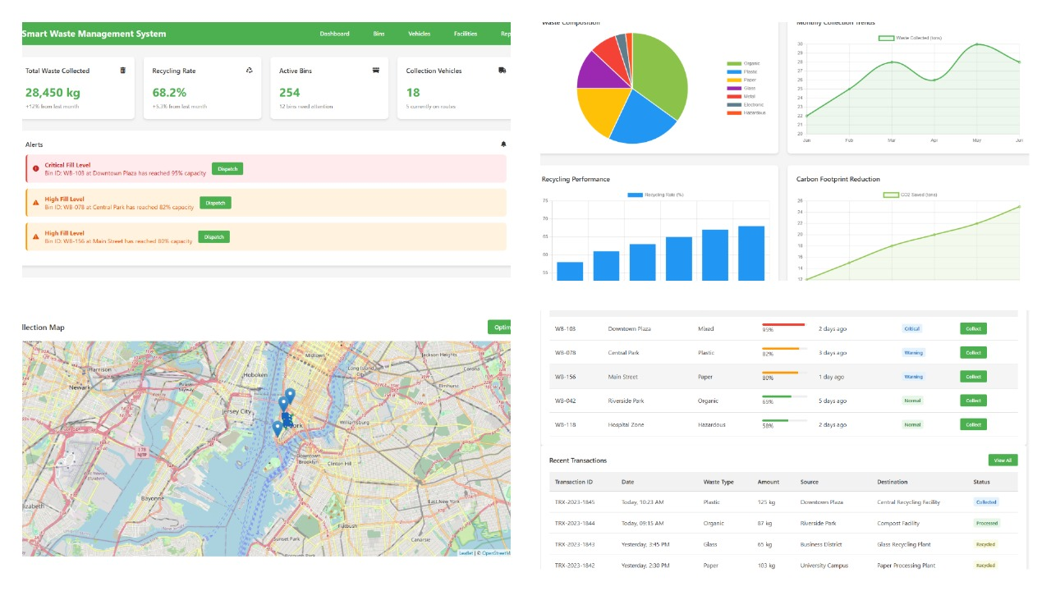
Outcome

Slide 10



Conclusion
Promote Sustainability
1
Cleaner, smarter cities.
Enhance Recycling
2
Reduces landfill waste.
Optimize Waste Collection
3
Minimizes environmental impact.
The Smart Waste Management System optimizes waste handling through AI and IoT, ensuring efficiency, sustainability, and a cleaner future.

Slide 11

Thank you
AI Meets Waste—Turning Trash into Tomorrow’s Innovation! 🤖♻️

